Slide 1
Machine Learning
Chapter 3
DECISION TREE LEARNING

Slide 2
Introduction
Decision tree learning is a method for approximating discrete-valued target functions, in which the learned function is represented by a decision tree.
Learned trees can also be re-represented as sets of if-then rules to improve human readability

Slide 3
DECISION TREE REPRESENTATION
Decision trees classify instances by sorting them down the tree from the root to some leaf node, which provides the classification of the instance.
Each node in the tree specifies a test of some attribute of the instance, and each branch descending from that node corresponds to one of the possible values for this attribute.
An instance is classified by starting at the root node of the tree, testing the attribute specified by this node, then moving down the tree branch corresponding to the value of the attribute in the given example.
This process is then repeated for the subtree rooted at the new node.

Slide 4
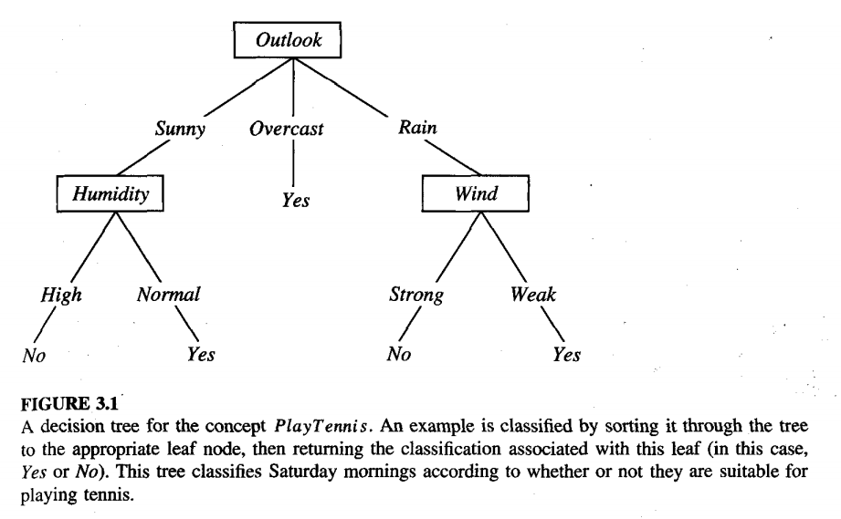
Figure 3.1 illustrates a typical learned decision tree.

Slide 5
This decision tree classifies Saturday mornings according to whether they are suitable for playing tennis.
For example, the instance
(Outlook = Sunny, Temperature = Hot, Humidity = High, Wind = Strong)
would be sorted down the leftmost branch of this decision tree and would therefore be classified as a negative instance (i.e., the tree predicts that PlayTennis = no)
In general, decision trees represent a disjunction of conjunctions of constraints on the attribute values of instances.
Each path from the tree root to a leaf corresponds to a conjunction of attribute tests, and the tree itself to a disjunction of these conjunctions.

Slide 6
For example, the decision tree shown in Figure 3.1 corresponds to the expression
(Outlook = Sunny Λ Humidity = Normal)
V (Outlook = Overcast)
v (Outlook = Rain Λ Wind = Weak)

Slide 7
APPROPRIATE PROBLEMS FOR DECISION TREE LEARNING
Although a variety of decision tree learning methods have been developed with somewhat differing capabilities and requirements, decision tree learning is generally best suited to problems with the following characteristics :
Instances are represented by attribute-value pairs. Instances are described by a fixed set of attributes (e.g., Temperature) and their values (e.g., Hot). The easiest situation for decision tree learning is when each attribute takes on a small number of disjoint possible values (e.g., Hot, Mild, Cold). However, extensions to the basic algorithm allow handling real-valued attributes as well (e.g., representing Temperature numerically).
The targetfunction has discrete output values. The decision tree assigns a boolean classification (e.g., yes or no) to each example. Decision tree methods easily extend to learning functions with more than two possible output values. A more substantial extension allows learning target functions with real-valued outputs, though the application of decision trees in this setting is less common.
Disjunctive descriptions may be required. decision trees naturally represent disjunctive expressions.
The training data may contain errors. Decision tree learning methods are robust to errors, both errors in classifications of the training examples and errors in the attribute values that describe these examples
The training data may contain missing attribute values. Decision tree methods can be used even when some training examples have unknown values (e.g., if the Humidity of the day is known for only some of the training examples).

Slide 8
Applications
Many practical problems have been found to fit these characteristics. Decision tree learning has therefore been applied to problems such as learning to classify medical patients by their disease, equipment malfunctions by their cause, and loan applicants by their likelihood of defaulting on payments. Such problems, in which the task is to classify examples into one of a discrete set of possible categories, are often referred to as classijication problems

Slide 9
THE BASIC DECISION TREE LEARNING ALGORITHM
Our basic algorithm, ID3, learns decision trees by constructing them top-down, beginning with the question “which attribute should be tested at the root of the tree?” To answer this question, each instance attribute is evaluated using a statistical test to determine how well it alone classifies the training examples.
The best attribute is selected and used as the test at the root node of the tree.
A descendant of the root node is then created for each possible value of this attribute, and the training examples are sorted to the appropriate descendant node (i.e., down the branch corresponding to the example's value for this attribute).
The entire process is then repeated using the training examples associated with each descendant node to select the best attribute to test at that point in the tree. This forms a greedy search for an acceptable decision tree, in which the algorithm never backtracks to reconsider earlier choices.

Slide 10
Which Attribute Is the Best Classifier?
The central choice in the ID3 algorithm is selecting which attribute to test at each node in the tree.
Select the attribute that is most useful for classifying examples.
What is a good quantitative measure of the worth of an attribute?
Define a statistical property, called informution gain, that measures how well a given attribute separates the training examples according to their target classification

Slide 11

ENTROPY MEASURES HOMOGENEITY OF EXAMPLES
The information theory, called entropy, that characterizes the impurity of an arbitrary collection of examples.
Given a collection S, containing positive and negative examples of some target concept, the entropy of S relative to this boolean classification is

Slide 12

where p+ is the proportion of positive examples in S and p- is the proportion of negative examples in S.
In all calculations involving entropy we define 0 log 0 to be 0.
To illustrate, suppose S is a collection of 14 examples of some boolean concept, including 9 positive and 5 negative examples (we adopt the notation [9+, 5-] to summarize such a sample of data).
Then the entropy of S relative to this boolean classification is
=.409+.530
For example, if all members are positive (p+ = I), then p- is 0, and Entropy(S) = -1 . log2(1) - 0 . log2 0 = -1 . 0 - 0 . log2 0 = 0.
Note the entropy is 1 when the collection contains an equal number of positive and negative examples.
If the collection contains unequal numbers of positive and negative examples, the entropy is between 0 and 1.

Slide 13
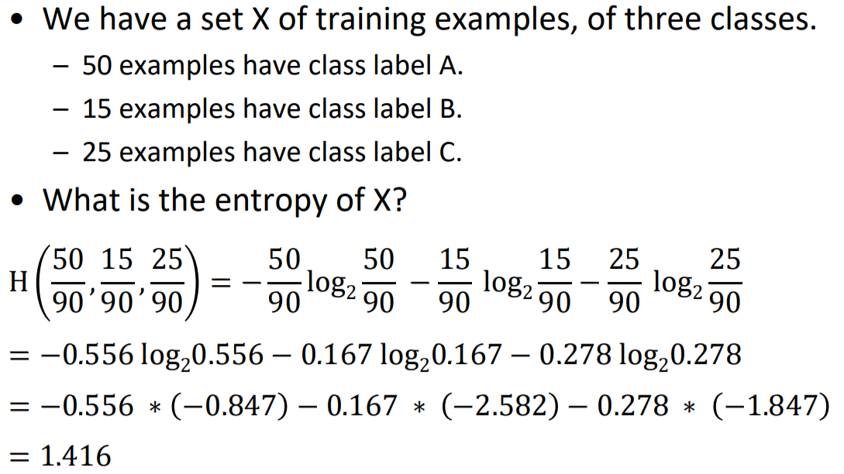

Slide 14
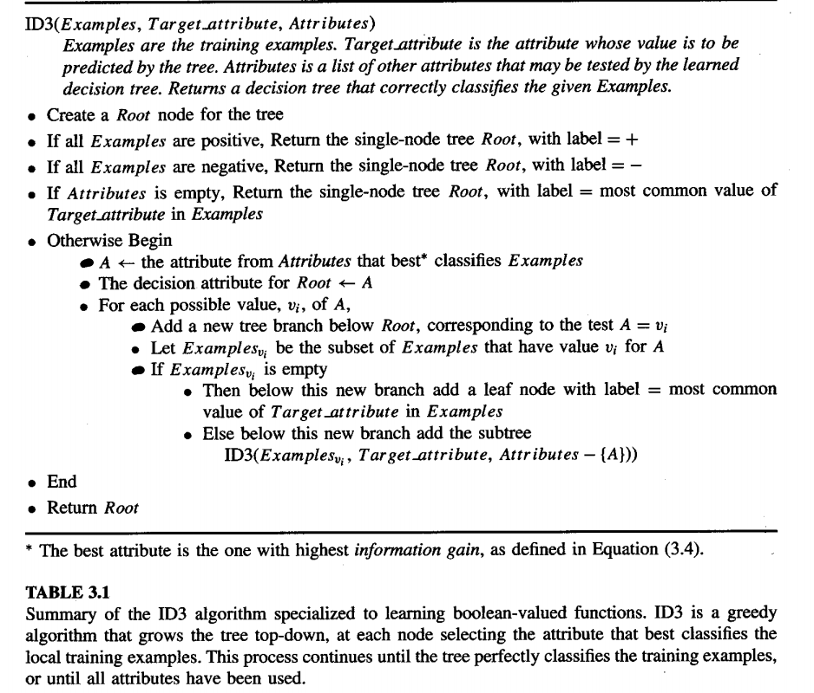

Slide 15
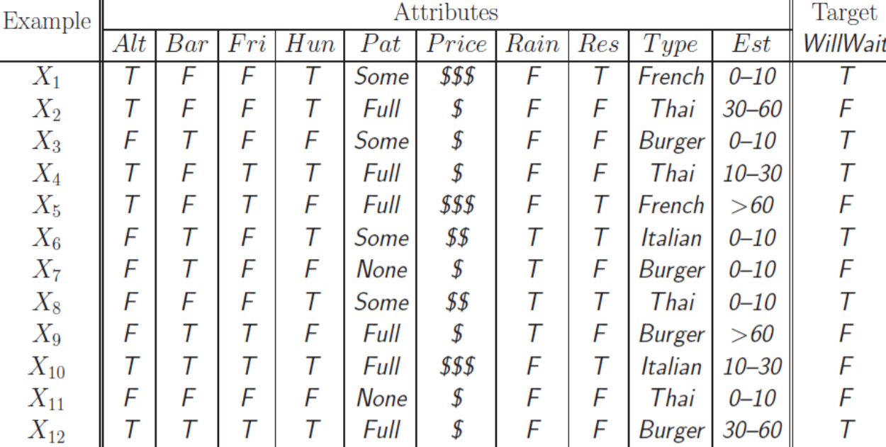

Slide 16
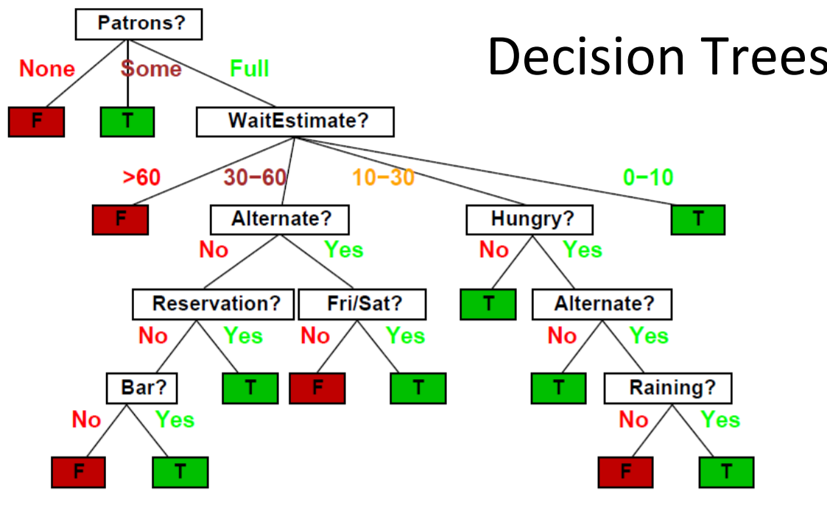
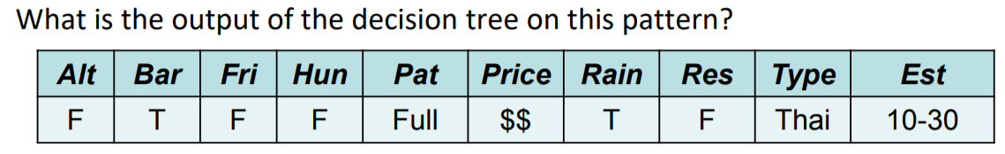

Slide 17

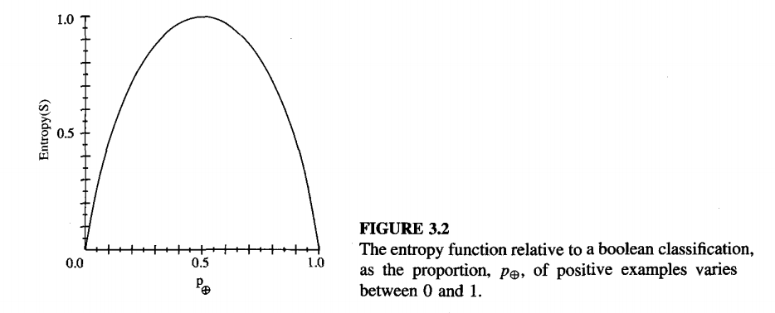
the entropy of S

Slide 18

One interpretation of entropy from information theory is that it specifies the minimum number of bits of information needed to encode the classification of an arbitrary member of S (i.e., a member of S drawn at random with uniform probability). For example, if p+ is 1, the receiver knows the drawn example will be positive, so no message need be sent, and the entropy is zero. On the other hand, p+ is 0.5, one bit is required to indicate whether the drawn example is positive or negative. If p+ is 0.8, then a collection of messages can be encoded using on average less than 1 bit per message by assigning shorter codes to collections of positive examples and longer codes to less likely negative example
if the target attribute can take on c different values, then the entropy of S relative to this c-wise classification is defined as C, where pi is the proportion of S belonging to class i.
if the target attribute can take on c possible values, the entropy can be as large as log, c.

Slide 19
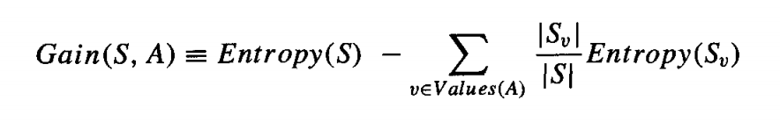
INFORMATION GAIN MEASURES THE EXPECTED REDUCTION IN ENTROPY
Given entropy as a measure of the impurity in a collection of training examples, we can now define a measure of the effectiveness of an attribute in classifying the training data.
The measure we will use, called information gain, is simply the expected reduction in entropy caused by partitioning the examples according to this attribute.
More precisely, the information gain, Gain(S, A) of an attribute A, relative to a collection of examples S, is defined as
where Values(A) is the set of all possible values for attribute A, and S, is the
subset of S for which attribute A has value v (i.e., Sv = {s Є SIA(s) = v}).

Slide 20
first term in Equation is just the entropy of the original collection S, and the second term is the expected value of the entropy after S is partitioned using attribute A. The expected entropy described by this second term is simply the sum of the entropies of each subset Sv, weighted by the fraction of examples that belong to Sv. Gain(S, A) is therefore the expected reduction in entropy caused by knowing the value of attribute A. Put another way, Gain(S, A) is the information provided about the target &action value, given the value of some other attribute A. The value of Gain(S, A) is the number of bits saved when
encoding the target value of an arbitrary member of S, by knowing the value of attribute A.

Slide 21
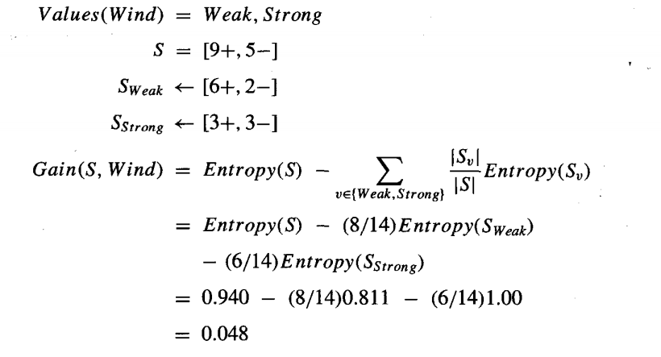
For example, suppose S is a collection of training-example days described by attributes including Wind, which can have the values Weak or Strong.
As before, assume S is a collection containing 14 examples, [9+, 5-1. Of these 14 examples, suppose 6 of the positive and 2 of the negative examples have Wind = Weak, and the remainder have Wind = Strong.
The information gain due to sorting the original 14 examples by the attribute Wind may then be calculated as

Slide 22
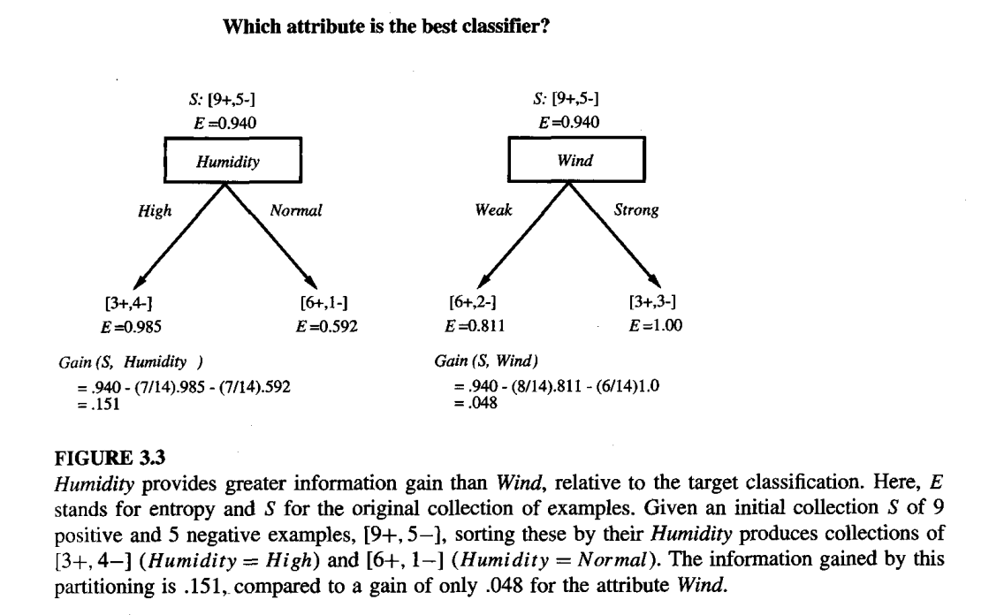

Slide 23
Gain
Information gain is precisely the measure used by ID3 to select the best attribute at
each step in growing the tree. The use of information gain to evaluate the relevance of attributes is summarized in Figure 3.3. In this figure the information gain of two different attributes, Humidity and Wind, is computed in order to determine which is the better attribute for classifying the training examples shown in Table 3.2.

Slide 24
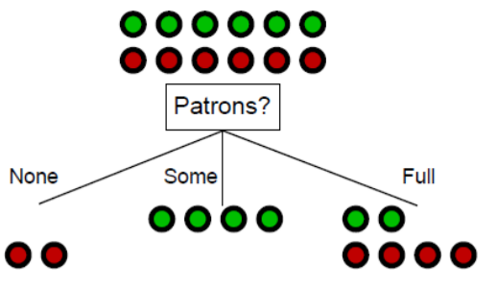
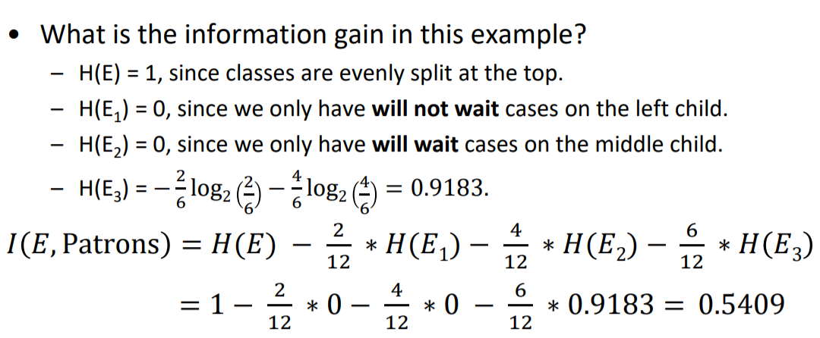

Slide 25
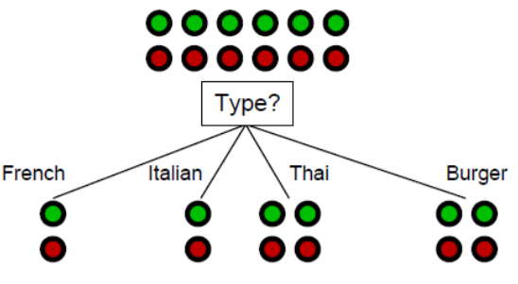
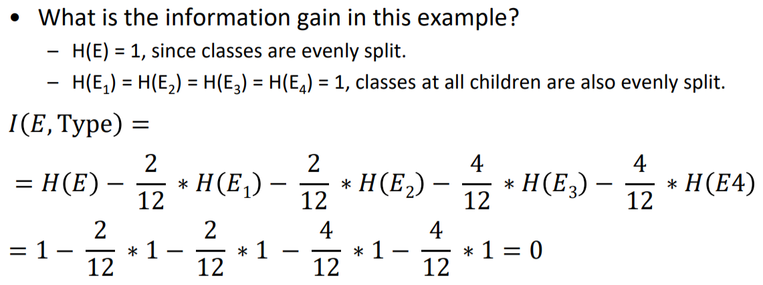

Slide 26
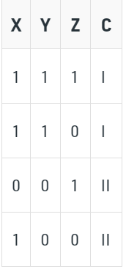
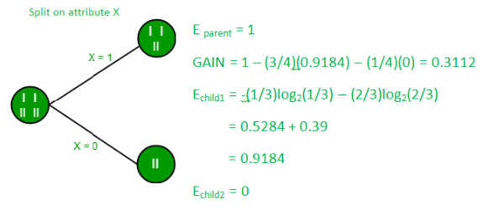
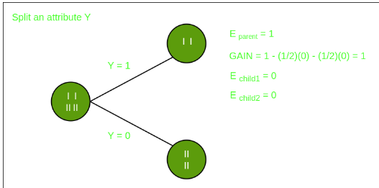

Slide 27
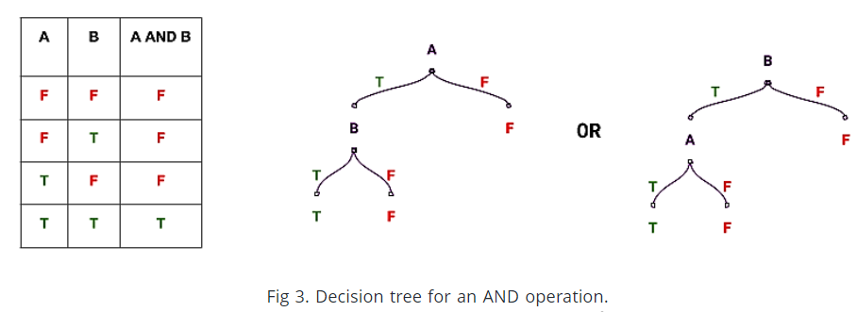
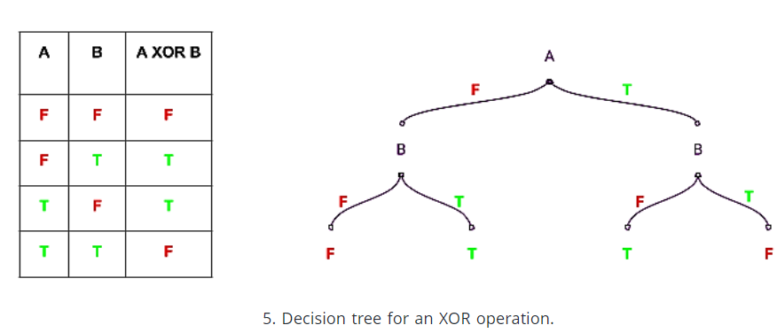

Slide 28
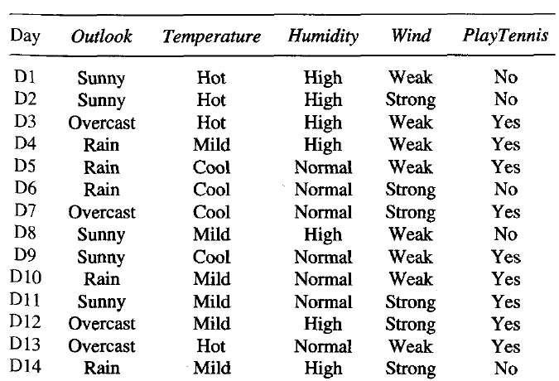

Slide 29
Gain(S, Outlook) = 0.246
Gain(S, Humidity) = 0.151
Gain(S, Wind) = 0.048
Gain(S, Temperature) = 0.029
ID3 determines the information gain for each candidate attribute (i.e., Outlook, Temperature, Humidity, and Wind), then selects the one with highest information gain. where S denotes the collection of training examples
According to the information gain measure, the Outlook attribute provides the best prediction of the target attribute, PlayTennis, over the training examples. Therefore, Outlook is selected as the decision attribute for the root node, and branches are created below the root for each of its possible values (i.e., Sunny, Overcast, and Rain).

Slide 30
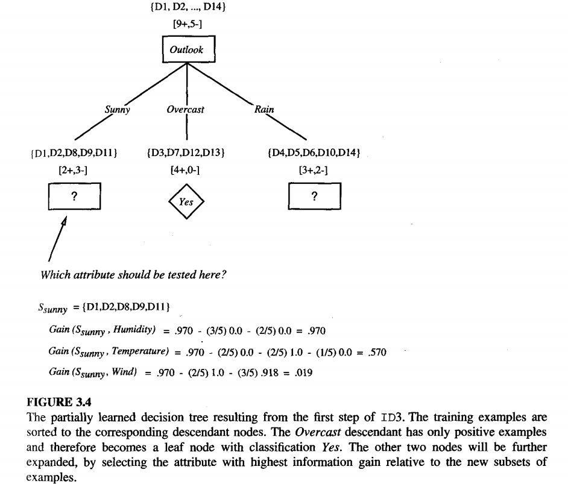
Every example for which Outlook = Overcast is also a positive example of PlayTennis. Therefore, this node of the tree becomes a leaf node with the classification PlayTennis = Yes. In contrast, the descendants corresponding to
Outlook = Sunny and Outlook = Rain still have nonzero entropy, and the decision
tree will be further elaborated below these nodes

Slide 31
ID3
The process of selecting a new attribute and partitioning the training examples is now repeated for each nontenninal descendant node, this time using only the training examples associated with that node. Attributes that have been incorporated higher in the tree are excluded, so that any given attribute can appear at most once along any path through the tree. This process continues for each new leaf node until either of two conditions is met: (1) every attribute has already been included along this path through the tree, or (2) the training examples associated with this leaf node all have the same target attribute value

Slide 32
HYPOTHESIS SPACE SEARCH IN DECISION TREE LEARNING
As with other inductive learning methods, ID3 can be characterized as searching a space of hypotheses for one that fits the training examples.
The hypothesis space searched by ID3 is the set of possible decision trees.
ID3 performs a simple-to complex, hill-climbing search through this hypothesis space, beginning with the empty tree, then considering progressively more elaborate hypotheses in search of a decision tree that correctly classifies the training data.

Slide 33
Limitations of ID3
ID3's hypothesis space of all decision trees is a complete space of finite discrete-valued functions, relative to the available attributes. Because every finite discrete-valued function can be represented by some decision tree, ID3 avoids one of the major risks of methods that search incomplete hypothesis spaces (such as methods that consider only conjunctive hypotheses): that the hypothesis space might not contain the target function.
ID3 maintains only a single current hypothesis as it searches through the space of decision trees. This contrasts, for example, with the earlier version space candidate-~lirninat-od, which maintains the set of all hypotheses consistent with the available training examples. By determining only a single hypothesis, ID^ loses the capabilities that follow from explicitly representing all consistent hypotheses. For example, it does not have the ability to determine how many alternative decision trees are consistent with the available training data, or to pose new instance queries that optimally resolve among these competing hypotheses.

Slide 34
Limitations
ID3 in its pure form performs no backtracking in its search. Once it,selects an attribute to test at a particular level in the tree, it never backtracks to reconsider this choice. Therefore, it is susceptible to the usual risks of hill-climbing search without backtracking: converging to locally optimal solutions that are not globally optimal. In the case of ID3, a locally optimal solution corresponds to the decision tree it selects along the single search path it explores. However, this locally optimal solution may be less desirable than trees that would have been encountered along a different branch of the search.

Slide 35
Limitations
ID3 uses all training examples at each step in the search to make statistically based decisions regarding how to refine its current hypothesis. This contrasts with methods that make decisions incrementally, based on individual training examples (e.g., FIND-S or CANDIDATE-ELIMINATOION )advantage of using statistical properties of all the examples (e.g., information gain) is that the resulting search is much less sensitive to errors in individual training examples. ID3 can be easily extended to handle noisy training data by modifying its termination criterion to accept hypotheses that imperfectly fit the training data

Slide 36
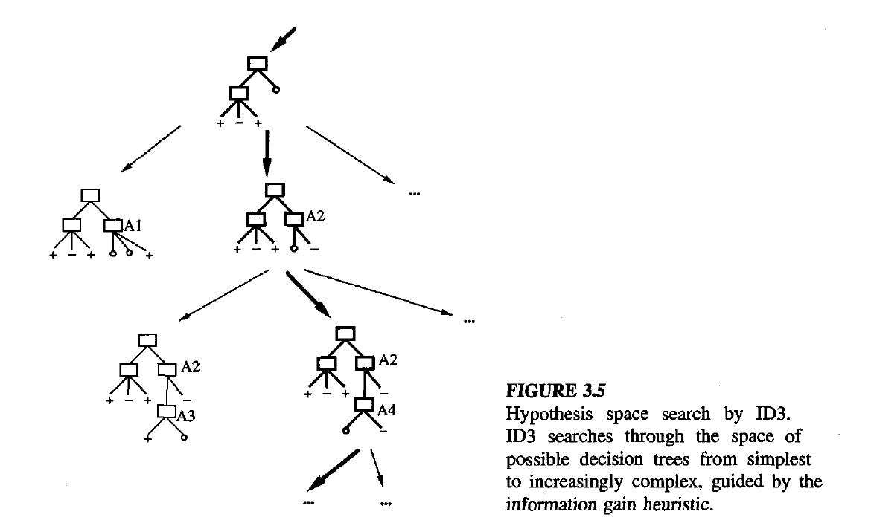

Slide 37
ISSUES IN DECISION TREE LEARNING
The algorithm described in Table 3.1 grows each branch of the tree just deeply enough to perfectly classify the training examples. While this is sometimes a reasonable strategy, in fact it can lead to difficulties when there is noise in the data, or when the number of training examples is too small to produce a representative sample of the true target function. In either of these cases, this simple algorithm can produce trees that overjt the training examples.
We will say that a hypothesis overfits the training examples if some other hypothesis that fits the training examples less well actually performs better over the entire distribution of instances (i.e., including instances beyond the training set).
Avoiding Overfitting the Data:
Definition: Given a hypothesis space H, a hypothesis h E H is said to overlit the training data if there exists some alternative hypothesis h' E H, such that h has smaller error than h' over the training examples, but h' has a smaller error than h over the entire distribution of instances.

Slide 38
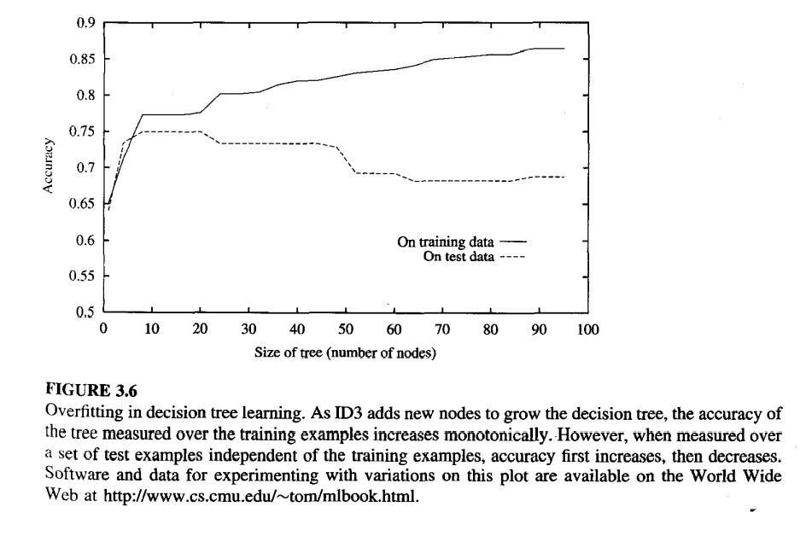
impact of overfitting in a typical application of decision tree learning. In this case, the ID3 algorithm is applied to the task of learning which medical patients have a form of diabetes. The horizontal axis of this plot indicates the total number of nodes in the decision tree, as the tree is being constructed.The vertical axis indicates the accuracy of predictions made by the tree.The solid line shows the accuracy of the decision tree over the training examples,whereas the broken line shows accuracy measured over an independent set of test examples (not included in the training set). Predictably, the accuracy of the tree over the training examples increases monotonically as the tree is grown. However, the accuracy measured over the independent test examples first increases, then decreases. As can be seen, once the tree size exceeds approximately 25 nodes, further elaboration of the tree decreases its accuracy over the test examples despite increasing its accuracy on the training examples.

Slide 39
overfitting
How can it be possible for tree h to fit the training examples better than h', but for it to perform more poorly over subsequent examples? One way this can occur is when the training examples contain random errors or noise. To illustrate, consider the effect of adding the following positive training example, incorrectly labeled as negative, to the (otherwise correct) examples
(Outlook = Sunny, Temperature = Hot, Humidity = Normal, Wind = Strong, PlayTennis = No) However, the addition of this incorrect example will now cause ID3 to construct a more complex tree.

Slide 40
In particular, the new example will be sorted into the second leaf node from the left in the learned tree of Figure 3.1, along with the previous positive examples D9 and Dl 1. Because the new example is labeled as a negative example, ID3 will search for further refinements to the tree below this node. Of course as long as the new erroneous example differs in some arbitrar way from the other examples affiliated with this node, ID3 will succeed in finding a new decision attribute to separate out this new example from the two previous positive examples at this tree node. The result is that ID3 will output a decision tree (h) that is more complex than the original tree from Figure 3.1 (h').

Slide 41
overfitting
The above example illustrates how random noise in the training examples can lead to overfitting. In fact, overfitting is possible even when the training data are noise-free, especially when small numbers of examples are associated with leaf nodes. In this case, it is quite possible for coincidental regularities to occur, in which some attribute happens to partition the examples very well, despite being unrelated to the actual target function. Whenever such coincidental regularities exist, there is a risk of overfitting.

Slide 42
There are several approaches to avoiding overfitting in decision tree learning.
These can be grouped into two classes:
approaches that stop growing the tree earlier, before it reaches the point where it perfectly classifies the training data,
approaches that allow the tree to overfit the data, and then post-prune the tree.
Although the first of these approaches might seem.more direct, the second approach of post-pruning overfit trees has been found to be more successful in practice. This is due to the difficulty in the first approach of estimating precisely when to stop growing the tree.

Slide 43
Criterion to be used to determine the correct final tree size.
Use a separate set of examples, distinct from the training examples, to evaluate the utility of post-pr
Use all the available data for training, but apply a statistical test to estimate whether expanding (or pruning) a particular node is likely to produce an improvement beyond the training set. For example, Quinlan (1986) uses a chi-square test to estimate whether further expanding a node is likely to improve performance over the entire instance distribution, or only on the current sample of training data.uning nodes from the tree.
Use an explicit measure of the complexity for encoding the training examples and the decision tree, halting growth of the tree when this encoding size is minimized. This approach, based on a heuristic called the Minimum Description Length principle

Slide 44
validation
The first of the above approaches is the most common and is often referred to as a training and validation set approach. We discuss the two main variants of this approach below. In this approach, the available data are separated into two sets of examples: a training set, which is used to form the learned hypothesis, and a separate validation set, which is used to evaluate the accuracy of this hypothesis over subsequent data and, in particular, to evaluate the impact of pruning this hypothesis. The motivation is this: Even though the learner may be misled by random errors and coincidental regularities within the training set, the validation
set is unlikely to exhibit the same random fluctuations. Therefore, the validation set can be expected to provide a safety check against overfitting the spurious characteristics of the training set. Of course, it is important that the validation set be large enough to itself provide a statistically significant sample of the instances. One common heuristic is to withhold one-third of the available examples for the validation set, using the other two-thirds for training.

Slide 45
REDUCED ERROR PRUNING:
.One approach, called reduced-error pruning (Quinlan 1987), is to consider each of the decision nodes in the tree to be candidates for pruning.
Pruning a decision node consists of removing the subtree rooted at that node, making it a leaf node, and assigning it the most common classification of the training examples affiliated with that node. Nodes are removed only if the resulting pruned tree performs no worse than-the original over the validation set.
Nodes are pruned iteratively, always choosing the node whose removal most increases the decision tree accuracy over the validation set. Pruning of nodes continues until further pruning is harmful (i.e., decreases accuracy of the tree over the validation set).

Slide 46
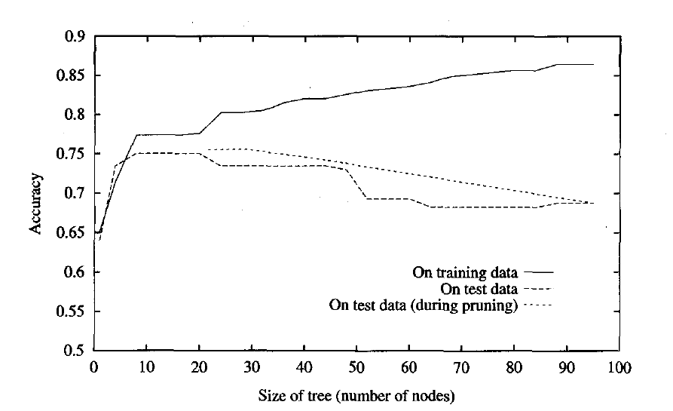
When pruning begins, the tree is at its maximum size and lowest accuracy over the test set. As pruning proceeds, the number of nodes is reduced and accuracy over the test set increases. Here, the available data has been split into three subsets: the training examples, the validation examples used for pruning the tree, and a set of test examples used to provide an unbiased estimate of accuracy over future unseen examples.
Using a separate set of data to guide pruning is an effective approach provided a large amount of data is available. The major drawback of this approach is that when data is limited, withholding part of it for the validation set reduces even further the number of examples available for training

Slide 47
3. Rule Post Pruning:
one quite successful method for finding high accuracy hypotheses is a technique we shall call rule post-pruning.
A variant of this pruning method is used by C4.5 (Quinlan 1993), which is an outgrowth of the original ID3 algorithm.
Rule post-pruning involves the following steps:
Infer the decision tree from the training set, growing the tree until the training data is fit as well as possible and allowing overfitting to occur.
Convert the learned tree into an equivalent set of rules by creating one rule for each path from the root node to a leaf node.
Prune (generalize) each rule by removing any preconditions that result in improving its estimated accuracy.
Sort the pruned rules by their estimated accuracy, and consider them in this sequence when classifying subsequent instances.
In rule postpruning, one rule is generated for each leaf node in the tree. Each attribute test along the path from the root to the leaf becomes a rule antecedent (precondition) and the classification at the leaf node becomes the rule consequent (postcondition).
Figure 3.1 is translated into the rule
IF (Outlook = Sunny) Λ (Humidity = High)
THEN PlayTennis = No
No pruning step is performed if it reduces the estimated rule accuracy. Tennis = No

Slide 48
Why convert the decision tree to rules before pruning?
There are three main advantages.
Converting to rules allows distinguishing among the different contexts in which a decision node is used. Because each distinct path through the decision tree node produces a distinct rule, the pruning decision regarding that attribute test can be made differently for each path. In contrast, if the tree itself were pruned, the only two choices would be to remove the decision node completely, or to retain it in its original form.
Converting to rules removes the distinction between attribute tests that occur near the root of the tree and those that occur near the leaves. Thus, we avoid messy bookkeeping issues such as how to reorganize the tree if the root node is pruned while retaining part of the subtree below this test.
Converting to rules improves readability. Rules are often easier for to understand.

Slide 49
4. Incorporating Continuous-Valued Attributes :
Our initial definition of ID3 is restricted to attributes that take on a discrete set of values.
First, the target attribute whose value is predicted by the learned tree must be discrete valued.
Second, the attributes tested in the decision nodes of the tree must also be discrete valued.
This second restriction can easily be removed so that continuous-valued decision attributes can be incorporated into the learned tree.
This can be accomplished by dynamically defining new discrete valued attributes that partition the continuous attribute value into a discrete set of intervals. In particular, for an attribute A that is continuous-valued, the algorithm can dynamically create a new boolean attribute A, that is true if A < c and false otherwise. The only question is how to select the best value for the threshold c.

Slide 50
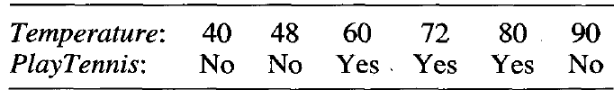
pick a threshold, c, that produces the greatest information gain. By sorting the examples according to the continuous attribute A, then identifying adjacent examples that differ in their target classification, we can generate a set of candidate thresholds midway between the corresponding values of A. These candidate thresholds can then be evaluated by computing the information gain associated with each.

Slide 51
In the current example, there are two candidate thresholds, corresponding to the values of Temperature at which the value of PlayTennis changes: (48 + 60)/2, and (80 + 90)/2. The information gain can then be computed for each of the candidate attributes, Temperature>54,and Temperature>85, and the best can be selected (Temperature>54). This dynamically created boolean attribute can then compete with the other discrete-valued candidate attributes available for growing the decision tree

Slide 52
5. Alternative Measures for Selecting Attributes:
There is a natural bias in the information gain measure that favors attributes withmany values over those with few values.
As an extreme example, consider the attribute Date, which has a very large number of possible values (e.g., March 4, 1979). If we were to add this attribute to the data in Table 3.2, it would have the highest information gain of any of the attributes. This is because Date alone perfectly predicts the target attribute over the training data. Thus, it would be selected as the decision attribute for the root node of the tree and lead to a (quite broad) tree of depth one, which perfectly classifies the training data. Of course, this decision tree would fare poorly on subsequent examples, because it is not a useful predictor despite the fact that it perfectly separates the training data.

Slide 53
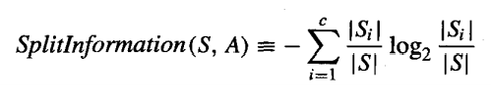
5. Alternative Measures for Selecting Attributes:
One alternative measure that has been used successfully is the gain ratio (Quinlan 1986).
The gain ratio measure penalizes attributes such as Date by incorporating a term, called split information, that is sensitive to how broadly and uniformly the attribute splits the data:
where S1 through S, are the c subsets of examples resulting from partitioning S
by the c-valued attribute A. Note that Splitlnfomzation is actually the entropy of
S with respect to the values of attribute A. This is in contrast to our previous
uses of entropy, in which we considered only the entropy of S with respect to the
target attribute whose value is to be predicted by the learned tree.

Slide 54

The Gain Ratio measure is defined in terms of the earlier Gain measure, as well as this Splitlnformation, as follows
the Splitlnfomzation term discourages the selection of attributes with many uniformly distributed values. For example, consider a collection of n examples that are completely separated by attribute A (e.g., Date). In this case, the Splitlnfomzation value will be log, n. In contrast, a boolean attribute B that splits the same n examples exactly in half will have Splitlnfomzation of 1. If attributes A and B produce the same information gain, then clearly B will score higher according to the Gain Ratio measure.

Slide 55

One practical issue that arises in using GainRatio in place of Gain to select attributes is that the denominator can be zero or very small when
for one of the Si. This either makes the GainRatio undefined or very large for attributes that happen to have the same value for nearly all members of S. To avoid selecting attributes purely on this basis, we can adopt some heuristic such as first calculating the Gain of each attribute, then applying the GainRatio test only considering those attributes with above average Gain

Slide 56
Handling Training Examples with Missing Attribute Values:
In certain cases, the available data may be missing values for some attributes. For example, in a medical domain in which we wish to predict patient outcome based on various laboratory tests, it may be that the lab test Blood-Test-Result is available only for a subset of the patients. In such cases, it is common to estimate the missing attribute value based on other examples for which this attribute has a known value.One strategy for dealing with the missing attribute value is to assign it the value that is most common among training examples at node n.

Slide 57
Alternatively, we might assign it the most common value among examples at node n that have the classification c(x).
The elaborated training example using this estimated value for A(x) can then be used directly by the existing decision tree learning algorithm.

Slide 58
A second, more complex procedure is to assign a probability to each of the possible values of A rather than simply assigning the most common value to A(x). These probabilities can be estimated again based on the observed frequencies of the various values for A among the examples at node n. For example, given a boolean attribute A, if node n contains six known examples with A = 1 and four with A = 0, then we would say the probability that A(x) = 1 is 0.6, and the probability that A(x) = 0 is 0.4. A fractional 0.6 of instance x is now distributed down the branch for A = 1, and a fractional 0.4 of x down the other tree branch.

Slide 59
Handling Attributes with Differing Costs
In some learning tasks the instance attributes may have associated costs. For example, in learning to classify medical diseases we might describe patients I terms of attributes such as Temperature, BiopsyResult, Pulse, BloodTestResults, etc. These attributes vary significantly in their costs, both in terms of monetary cost and cost to patient comfort. In such tasks, we would prefer decision trees that use low-cost attributes where possible, relying on high-cost attributes only when needed to produce reliable classifications.

Slide 60


ID3 can be modified to take into account attribute costs by introducing a cost term into the attribute selection measure.
divide the Gpin by the cost of the attribute, so that lower-cost attributes would be preferred. While such cost-sensitive measures do not guarantee finding an optimal cost-sensitive decision tree, they do bias the search in favor of low-cost attributes.
Tan and Schlimmer (1990) and Tan (1993) used
Nunez (1988) used
where w E [0, 11 is a constant that determines the relative importance of cost
versus information gain.

